Slide 1
OOP PROJECT
Submitted By:
2000542 Rishee Deshmukh EN20CS301350
2002685 Prakhyat Wadhwa EN20CS301301
Under the guidance of:
Asst. Prof. Mr Arpit Deo

Slide 2

TOPICS TO COVER
Secret Diary
Encryption
A.S.C.I.I.

Slide 3

SECRET DIARY
WHAT IS A SECRET DIARY?
WHY DOES ONE MIGHT WANT TO KEEP IT?
HOW TO MAKE ONE FOR OURSELVES?

Slide 4

ENCRYPTION
WHAT IS ENCRYPTION?
WHY IS IT NEEDED?
HOW IS IT HELPFUL?

Slide 5


A.S.C.I.I.
ASCII??
WHAT IS ASCII?
WHAT IS IT’S SIGNIFICANCE?
WHERE IS IT USED?

Slide 6
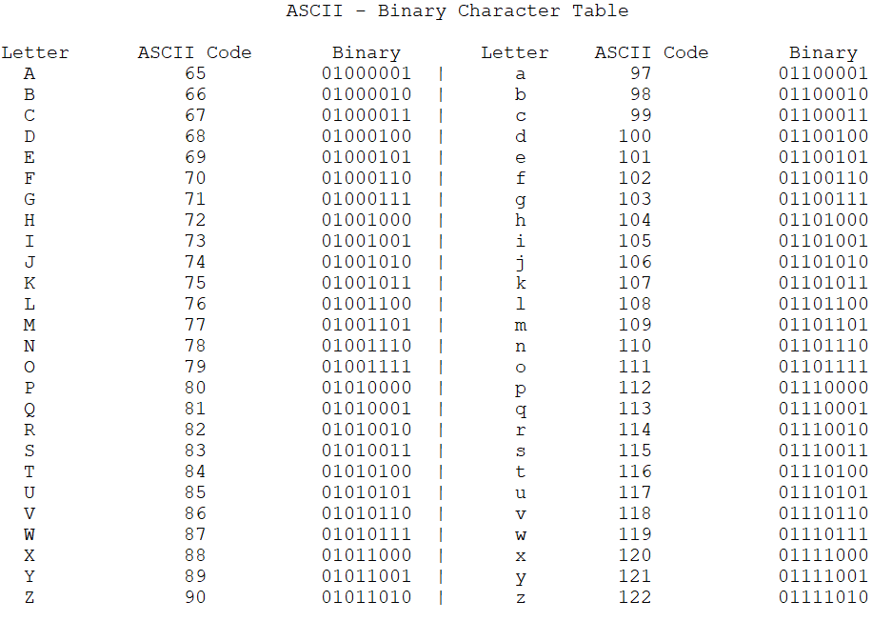

Slide 7
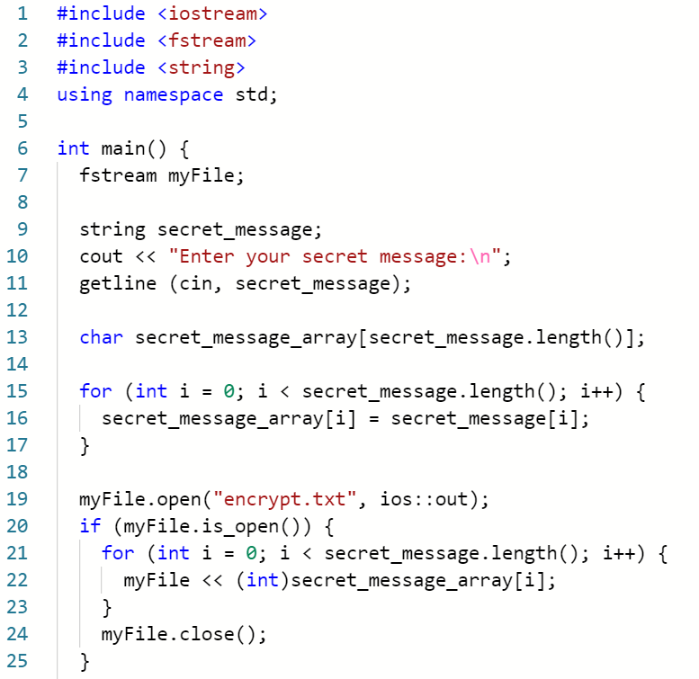
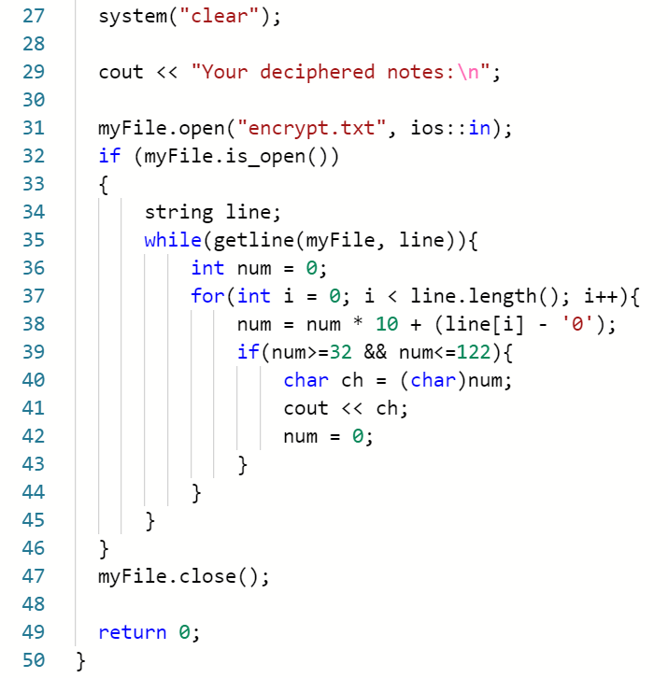
SOURCE CODE

Slide 8

IMPROVEMENTS THAT CAN BE MADE
Password system can be added for better security.
A prompt for user password input whenever the user decides to decipher their notes to read it.
Adding a GUI.

Slide 9


